Slide 1

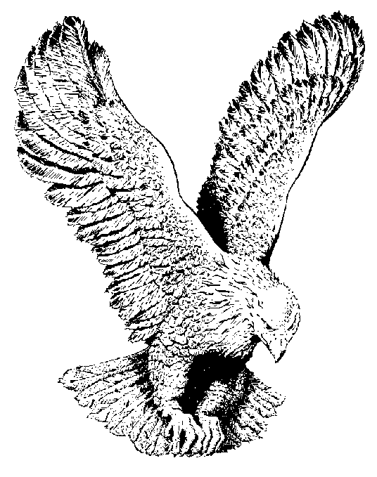
784 THE TRUMPET SHALL SOUND
The trumpet shall sound
The dead shall rise,
And the Lord shall be waiting in the skies.
Then we who remain, shall be changed
In the twinkling of an eye.

Slide 2
Glory! Glory! Glory! Glory!
Hallelujah to His Name!
Yesterday, today, forever,
Our Jesus is the same!

